Slide 1
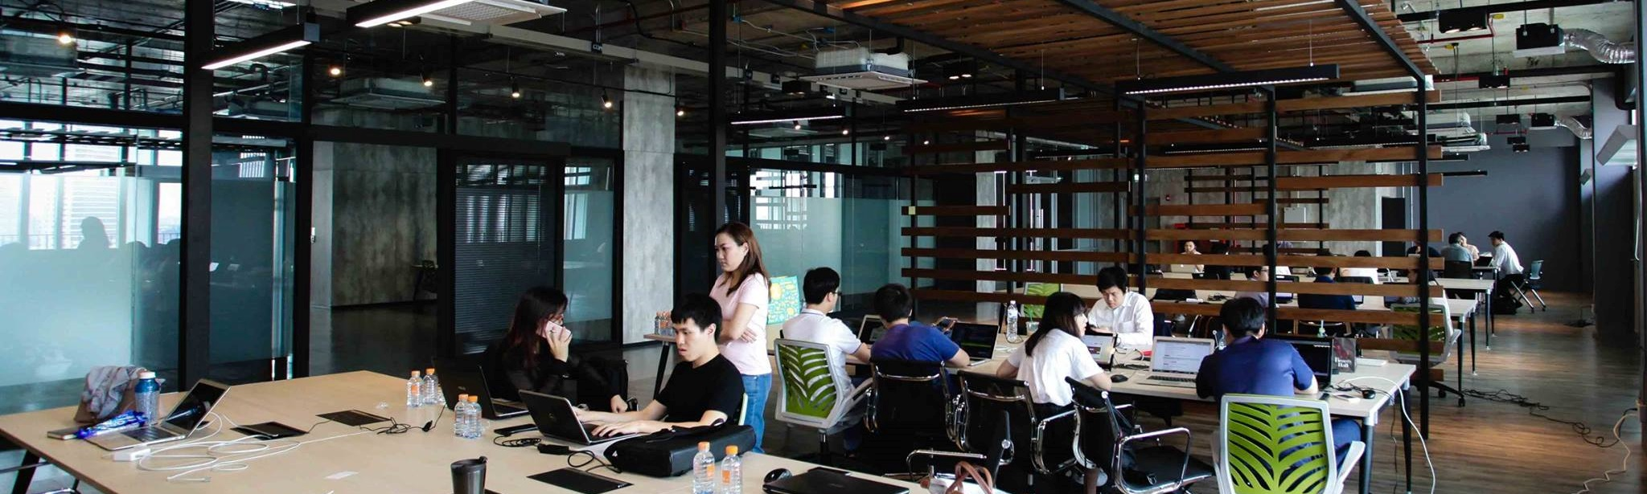
KMUTT Entrepreneurship Academy
KMUTT’S ROLE IN ENTREPRENEURSHIP DEVELOPMENT

Slide 2
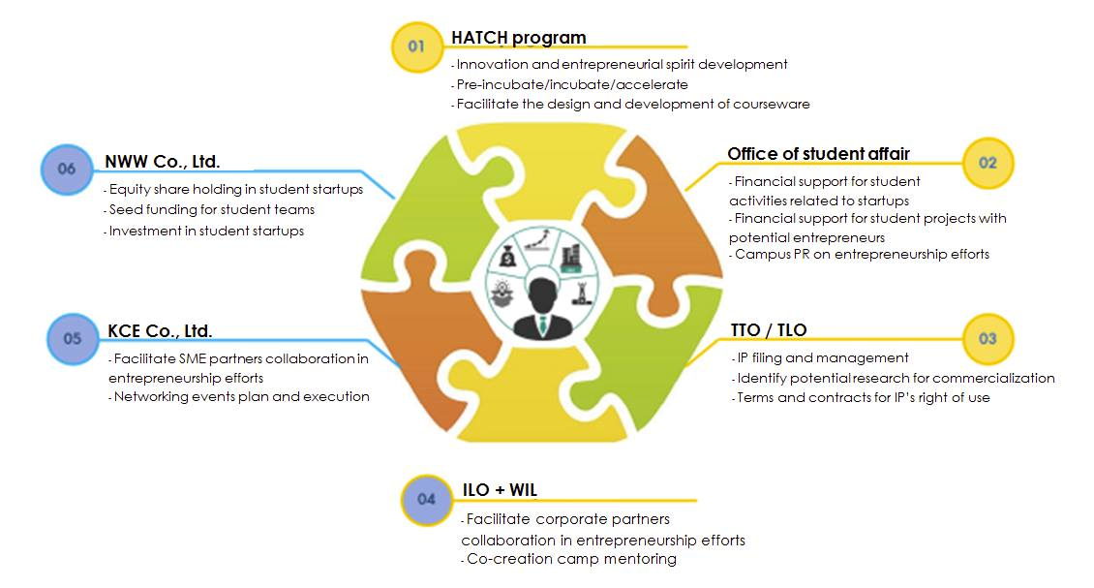
The Ecosystem
& KX

Slide 3

Students Transformation
Entrepreneurial University: A Strategic Plan at KMUTT

Slide 4
Slides borrowed from KX pitching deck
SMEs / Corporates / Students
Supporting ecosystem
Environmental Factor
Stakeholder
economic

Slide 5
Slides borrowed from KX pitching deck
SMEs / Corporates / Students
economic
Supporting ecosystem
Environmental Factor
Stakeholder

Slide 6
Slides borrowed from KX pitching deck
Innovation
Ecosystem
SMEs / Corporates / Students
economic
Supporting ecosystem
Environmental Factor
Stakeholder

Slide 7
Slides borrowed from KX pitching deck
Incubation/ Acceleration
Innovation
Ecosystem
SMEs / Corporates / Students
economic
Supporting ecosystem
Environmental Factor
Stakeholder

Slide 8
Slides borrowed from KX pitching deck
Incubation/ Acceleration
Mentoring
Innovation
Ecosystem
SMEs / Corporates / Students
economic
Supporting ecosystem
Environmental Factor
Stakeholder

Slide 9
Slides borrowed from KX pitching deck
Incubation/ Acceleration
Mentoring
Funds / Capital Networks
Innovation
Ecosystem
SMEs / Corporates / Students
economic
Supporting ecosystem
Environmental Factor
Stakeholder

Slide 10
Slides borrowed from KX pitching deck
Incubation/ Acceleration
Mentoring
Funds / Capital Networks
Innovation
Ecosystem
Technology Providers
SMEs / Corporates / Students
economic
Supporting ecosystem
Environmental Factor
Stakeholder

Slide 11
Slides borrowed from KX pitching deck
Incubation/ Acceleration
Mentoring
Funds / Capital Networks
Innovation
Ecosystem
Technology Providers
SMEs / Corporates / Students
Technology Integrators
economic
Supporting ecosystem
Environmental Factor
Stakeholder

Slide 12
Slides borrowed from KX pitching deck
Incubation/ Acceleration
Mentoring
Funds / Capital Networks
Innovation
Ecosystem
Technology Providers
SMEs / Corporates / Students
Educational Programs / Training
Technology Integrators
economic
Supporting ecosystem
Environmental Factor
Stakeholder

Slide 13
Slides borrowed from KX pitching deck
Incubation/ Acceleration
Mentoring
Funds / Capital Networks
Innovation
Ecosystem
Advisory Services
Technology Providers
SMEs / Corporates / Students
Educational Programs / Training
Technology Integrators
economic
Supporting ecosystem
Environmental Factor
Stakeholder

Slide 14
Slides borrowed from KX pitching deck
Incubation/ Acceleration
Mentoring
Coordination
Funds / Capital Networks
Innovation
Ecosystem
Advisory Services
Technology Providers
Technology provider / sourcing / assessment
SMEs / Corporates / Students
Educational Programs / Training
Technology Integrators
economic
Supporting ecosystem
Environmental Factor
Stakeholder

Slide 15
Incubation/ Acceleration
Mentoring
Env. Factor
Coordination
Funds / Capital Networks
Innovation
Ecosystem
Advisory Services
Technology Providers
SMEs / Corporates / Students
Educational Programs / Training
Technology Integrators
economic
Supporting ecosystem
Environmental Factor
Stakeholder

Slide 16
broadcast
event
Incubation/ Acceleration
Mentoring
Access to Talent
workshop
Env. Factor
training
library
Access to Capital
Coordination
Funds / Capital Networks
Access to Know-how
Innovation
Ecosystem
Supportive Culture
Advisory Services
Technology Providers
SMEs / Corporates / Students
party
Supportive Public Policies
exhibition
events
Educational Programs / Training
Technology Integrators
economic
Supporting ecosystem
Environmental Factor
Stakeholder

Slide 17

Our Goals
Raise awareness and inspire (50% of our students)
Build an entrepreneurial mindset
Talk, call for ideas, campus tour, camps, competitions
Educate and train (10% of our students)
Educate the concept of how to build a business using experiential-based methods
3 GenEd courses + 2 courses on commercializing your projects
Incubate and accelerate (1% of our students)
Build student startups

Slide 18

Raise Awareness and Inspiration
Goal: Build an innovative and entrepreneurial spirits
Activities:
Series of talk
Call for Idea
Campus tours
Digital PR : Blogs and News on Hatch social medai
Encourage and help students to join competitions to gain inspiration (social, Tech, Business)

Slide 19

Educate and Train (Curriculum Integration)
Goal: Educate the concept of how to build a business using active learning methods
Target: 1,000 students
Activities: curriculum / courseware design, and material delivery
General education courses (GEN XXX)
Innovation and Entrepreneurship
Technology and Innovation for Sustainable Development
Digital Literacy for Entrepreneurs
Lab-to-market, a small class with PBL pedagogy, for graduate students
Commercializing Science and Technology Project (Undergraduate department elective)
To scale, we plan to build an E-learning platform for business courseware in the near future

Slide 20

Educate and Train
(Annual workshop Series)
Goal: Educate the concept through short training
Target: 500 KMUTT participants
Incubation Workshop Programs (8 Episodes) – once a year
Co-Creation Camp (2-3 days) – 4 times / year
KMUTT Boot camp – once a year

Slide 21
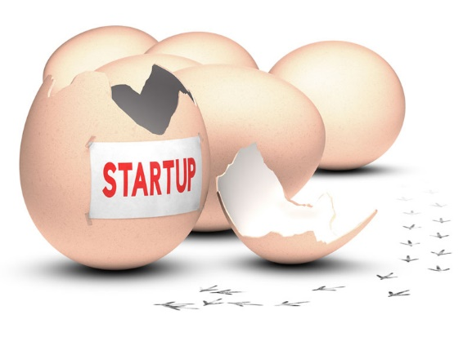
Incubate and Accelerate
Goal: Build student startups
Main Activities
Talent screening
Business incubation
Company incorporation
Other Activities:
Facilitate product development
Co-working space management
Mentoring
Seed Funding
Legal advisory and Financial consultancy

Slide 22


Camps
Experience entrepreneurship through camps and talks (1-2 days)
Inspire
Screening for potentials
Experience Problem/Solution Fit for a hypothetical startup ideas (4 weeks)
Level 0 (L0)
Educate and Train
Experience actual Problem/Solution journey using own startup ideas (3 months with 50k seed funding and consultations)
Level 1 (L1)
Level 2 (L2)
Accelerate
Experience actual Product/Market journey (fulltime for 4 months with 200k seed funding and co-working space, consultation, and networking)
Startup
Nawawiwat

Slide 23
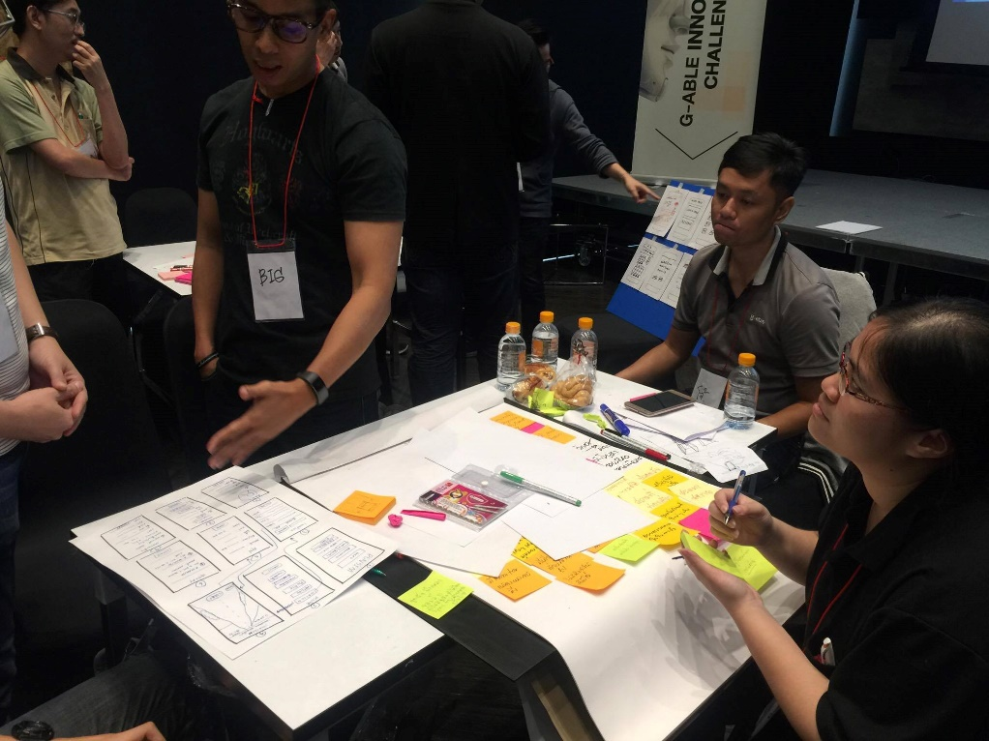
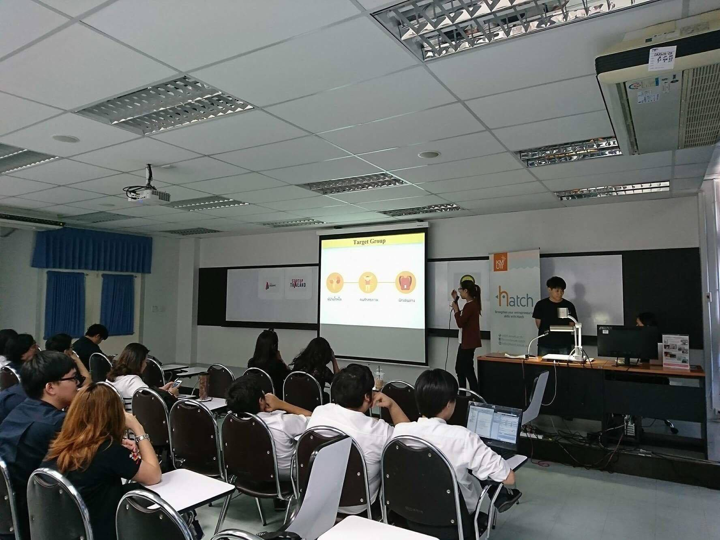
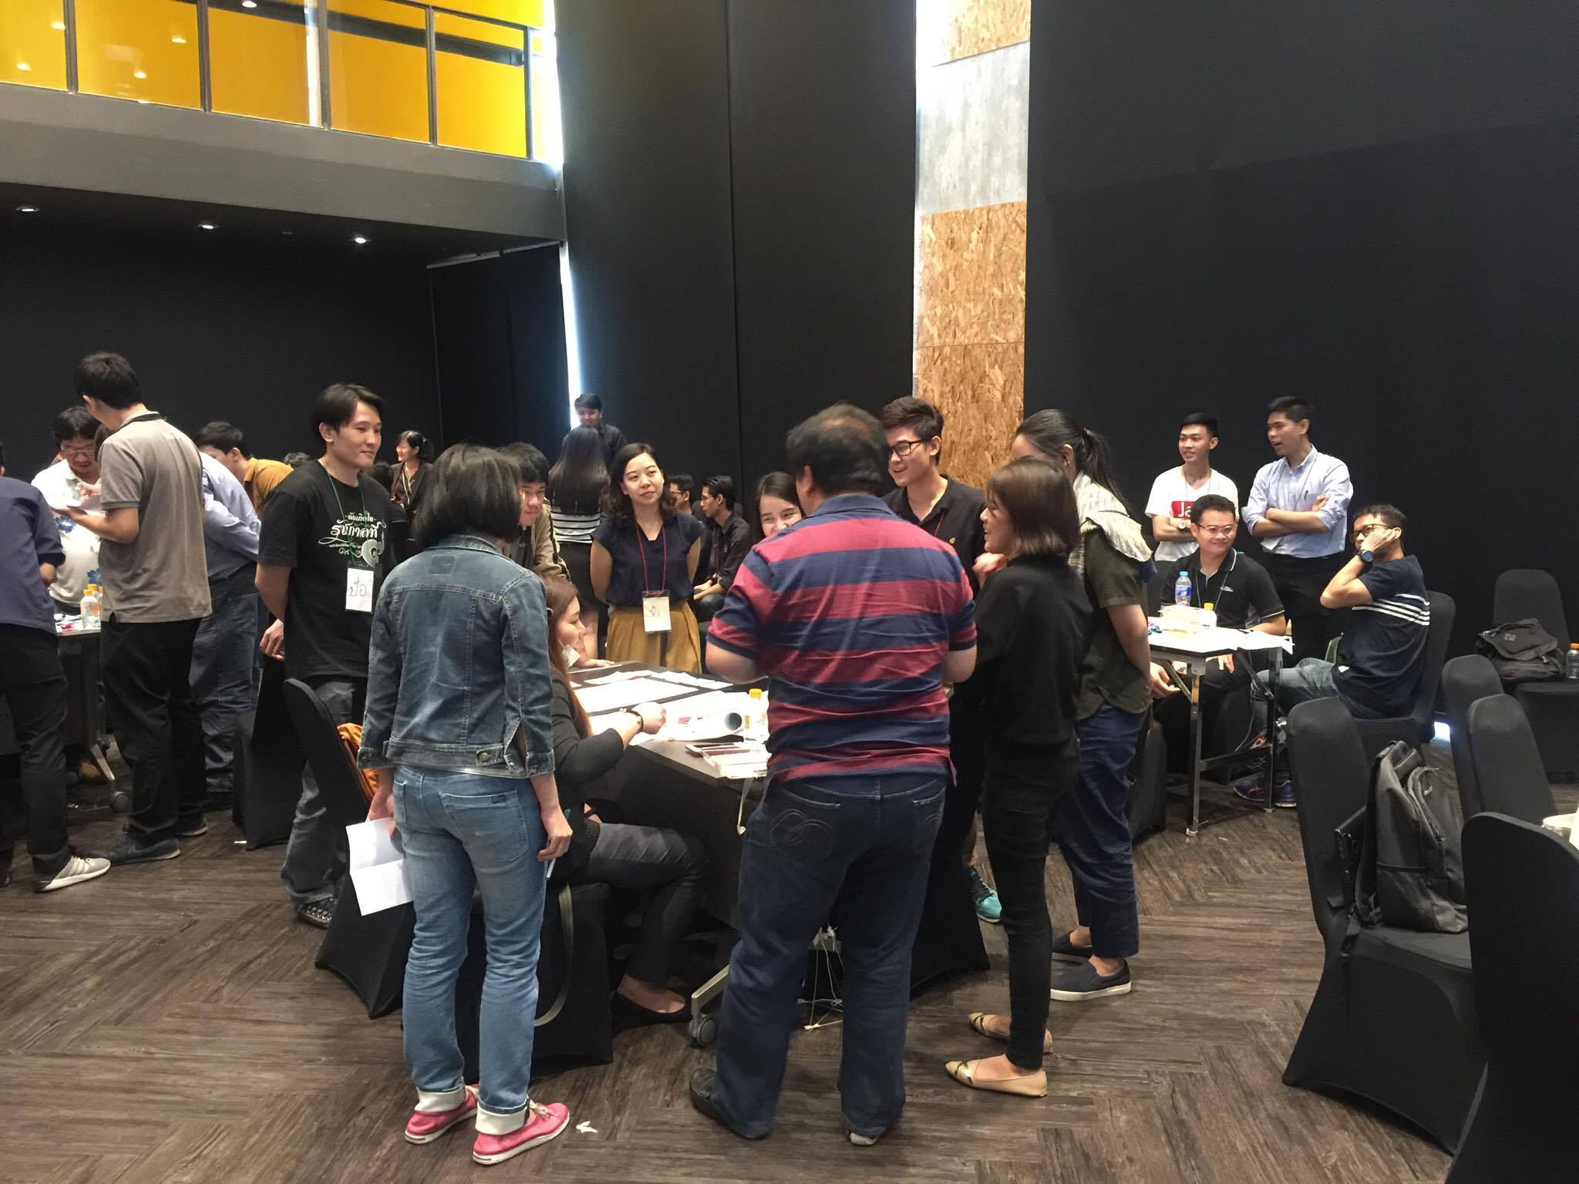
Co-Creation Camps @ KMUTT AND KX

Slide 24
Previous Co-Creation Camps in 2017
Camp 1 : Chatbot Hackathon @ KX in collaboration with SCB (March 2017), funded by SCB
Camp 2: FIN Tech @ KMUTT in collaboration with FinTech Association (August 2017), funded by STI
Camp 3: Marketing Tech @KX in collaboration with G-Able (September 2017), funded by STI and G-Able
Camp 4: Truck Accessories Design @ KX in collaboration with Aeroklas (November 2017), funded by EPG group

Slide 25
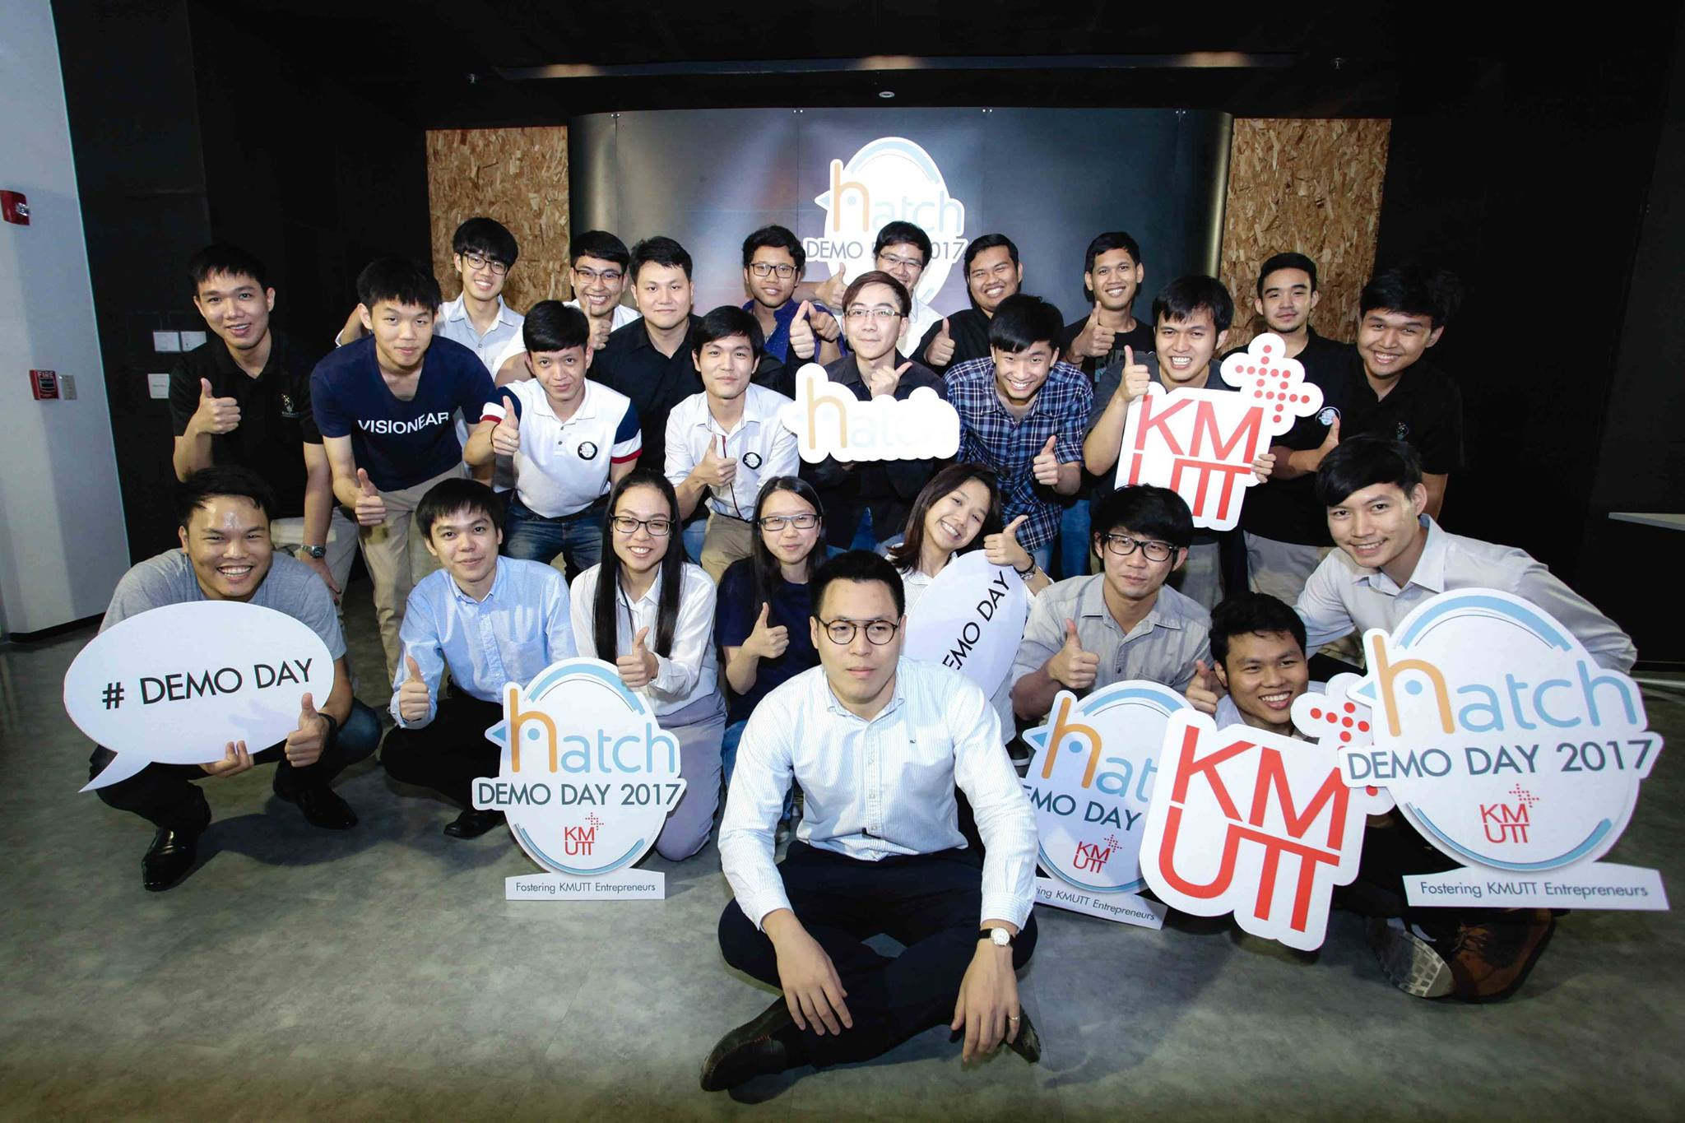
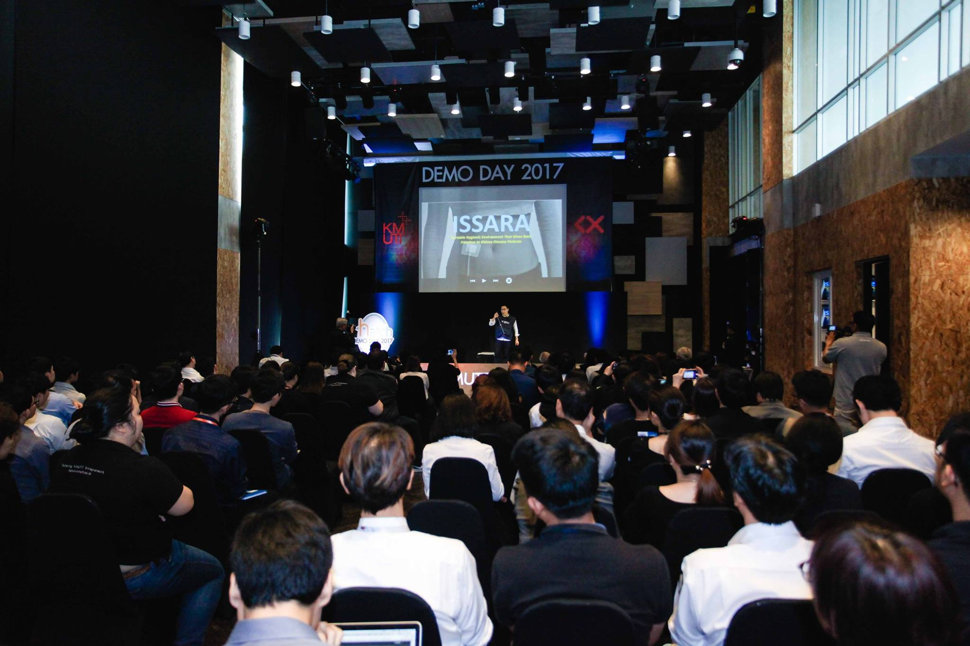
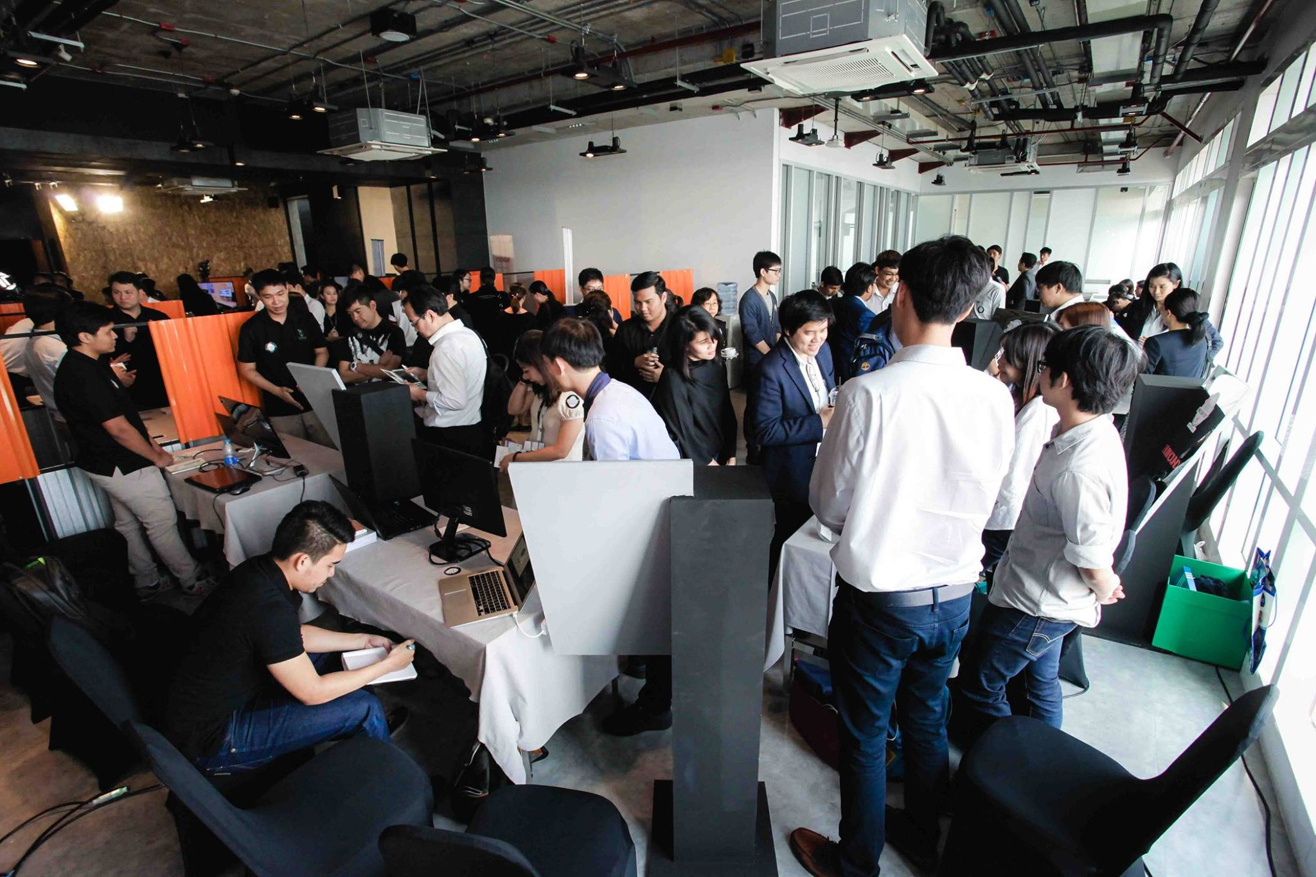
DEMO DAY 2017

Slide 26
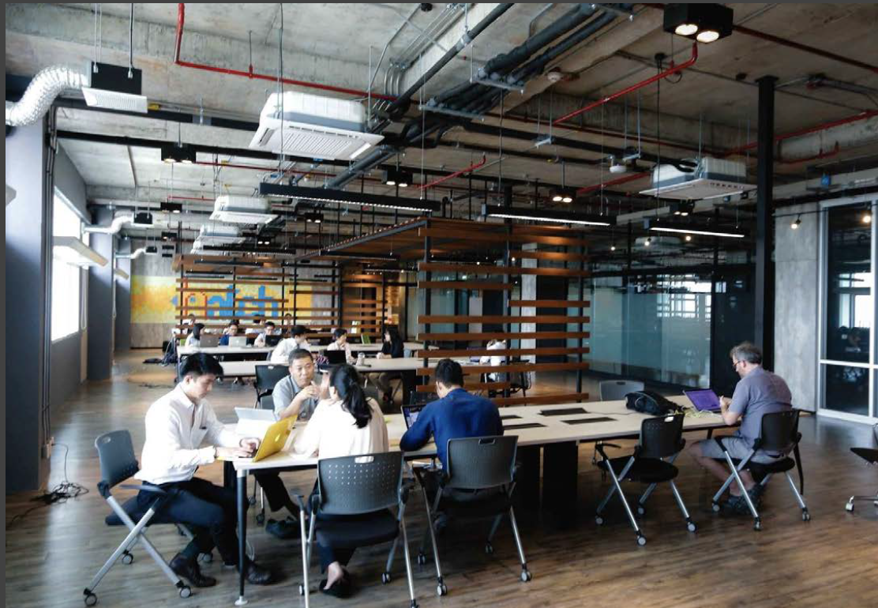
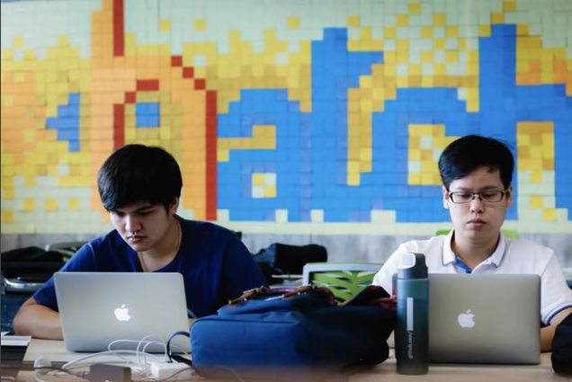
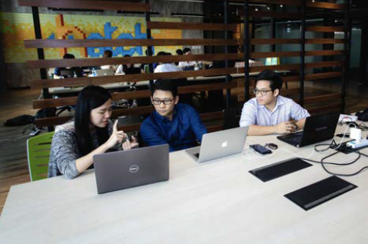
Hatch Co-Working Space

Slide 27






DEEP TECH HOUSE
Partners
Ecosystem
To create the innovation value chain for Thailand
Big data / Data Analytics
Machine Learning and AI
Virtual Reality / Augmented Reality
Internet of Things
Blockchain
Biometric

Slide 28

THE NEW GEN EXECUTIVES
Well-selected top students from KMUTT are recruited to take on the roles and responsibilities of top business executives of your organization.
THE NEW GEN EXECUTIVES will turn their critical gaze on professional and personal challenges found in your organization and address them.
For 15 weeks, they will divide their time between the headquarters, where they learn about your business operations, and the simulated boardroom, where they meet their Advisor to reflect on the lessons learned and to formulate a game plan to address your business challenges from their innovative fresh perspectives.

